Slide 1
CPT-S 415
Big Data
Yinghui Wu
EME B45

Slide 2
CPT-S 415
Big Data
Data stream processing
Data stream management: Overview
Data synopsis in data stream processing
Incremental query processing
Notes:
Object.

Slide 3
Streams – A Brave New World
Traditional DBMS: data stored in finite, persistent data sets
Data Streams: distributed, continuous, unbounded, rapid, time varying, noisy, . . .
Data-Stream Management: variety of modern applications
  Network monitoring and traffic engineering
  Sensor networks
  Telecom call-detail records
  Network security
  Financial applications
  Manufacturing processes
  Web logs and clickstreams
  Other massive data sets…

Slide 4
Data stream processing and DSMS

Slide 5
The DSMS Research Field
Active research field (~ 15 years) derived from the database community
  Stream algorithms
  Application and database perspective
Two syllabus articles:
  Brian Babcock, Shivnath Babu, Mayur Datar, Rajeev Motwani, Jennifer Widom: "Models and issues in data stream systems"
  Lukasz Golab, M. Tamer Ozsu: "Issues in data stream management”
Future: Complex Event Processing (CEP)

Slide 6
Data Streams - Terms
A data stream is a (potentially unbounded) sequence of tuples
Each tuple consist of a set of attributes, similar to a row in database table
Transactional data streams: log interactions between entities
  Credit card: purchases by consumers from merchants
  Telecommunications: phone calls by callers to dialed parties
  Web: accesses by clients of resources at servers
Measurement data streams: monitor evolution of entity states
  Sensor networks: physical phenomena, road traffic
  IP network: traffic at router interfaces
  Earth climate: temperature, moisture at weather stations

Slide 7
Motivation
Massive data sets:
  Huge numbers of users, e.g.,
    AT&T long-distance: ~ 300M calls/day
    AT&T IP backbone: ~ 10B IP flows/day
  Highly detailed measurements, e.g.,
    NOAA: satellite-based measurements of earth geodetics
  Huge number of measurement points, e.g.,
    Sensor networks with huge number of sensors
Near real-time analysis
  ISP: controlling service levels
  NOAA: tornado detection using weather radar
  Hospital: Patient monitoring
Traditional data feeds
  Simple queries (e.g., value lookup) needed in real-time
  Complex queries (e.g., trend analyses) performed off-line

Slide 8
DBMS vs. DSMS #1
SQL Query
Result
Continuous Query (CQ)
Result
Query Processing
Query Processing
Main Memory
Main Memory
Data Stream(s)
Data Stream(s)
Disk

Slide 9
DBMS vs. DSMS #2
DSMS:
  support on-line analysis of rapidly changing data streams
  data stream: real-time, continuous, ordered (implicitly by arrival time or explicitly by timestamp) sequence of items, too large to store entirely, not ending
  continuous queries
Traditional DBMS:
  stored sets of relatively static records with no pre-defined notion of time
  good for applications that require persistent data storage and complex querying

Slide 10
DBMS vs. DSMS #3
Persistent relations
One-time queries
Random access
“Unbounded” disk store
Only current state matters
Passive repository
Relatively low update rate
No real-time services
Assume precise data
Access plan determined by query processor, physical DB design
Transient streams
Continuous queries
Sequential access
Bounded main memory
History/arrival-order is critical
Active stores
Possibly multi-GB arrival rate
Real-time requirements
Data stale/imprecise
Unpredictable/variable data arrival and characteristics

Slide 11
DSMS Applications
Network security (e.g., iPolicy, NetForensics/Cisco, Niksun)
  Network packet streams, user session information
  URL filtering, detecting intrusions & DOS attacks & viruses
Sensor Networks
  Network Traffic Analysis
  Real time analysis of Internet traffic. E.g., Traffic statistics and critical condition detection.
Financial Tickers
  On-line analysis of stock prices, discover correlations, identify trends.
Transaction Log Analysis
  e.g. Web click streams and telephone calls
Pull-based
Push-based

Slide 12
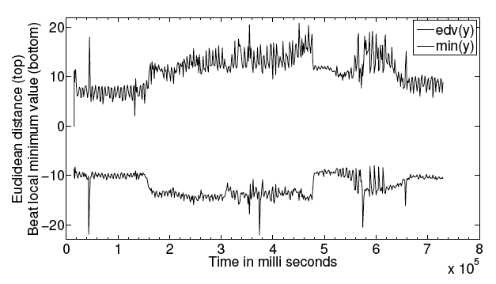
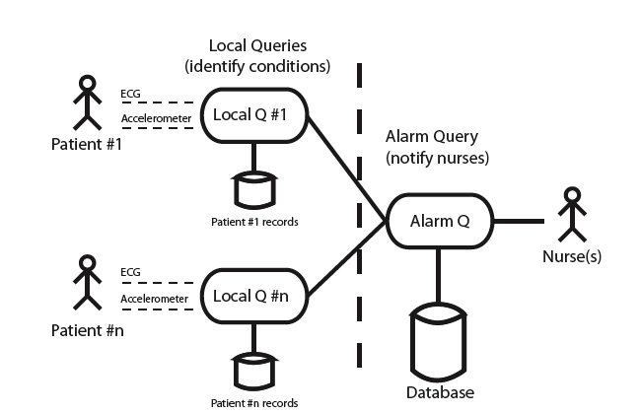
Application
Stig Støa, Morten Lindeberg and Vera Goebel. Online Analysis of Myocardial Ischemia From Medical Sensor Data Streams with Esper, 2009
Queries over sensor traces from surgical procedures on pigs performed at IVS, Rikshospitalet, running a open source java system called Esper
Successful identification of occlusion to the heart (heart attack)
Heart attack!
SELECT y, timestamp
FROM Accelerometer.win:ext_timed(t, 5 s)
HAVING count(y) BETWEEN 2 AND 200

Slide 13
What do we need?
Data model and query semantics: order- and time-based operations
  Selection
  Nested aggregation
  Multiplexing and demultiplexing
  Frequent item queries
  Joins
  Windowed queries
Query processing:
  Streaming query plans must use non-blocking operators
  Only single-pass algorithms over data streams
Data reduction: approximate summary structures
  Synopses, digests => no exact answers
Real-time reactions for monitoring applications => active mechanisms
Long-running queries: variable system conditions
Scalability: shared execution of many continuous queries, monitoring multiple streams
Notes:
Hashing vs strea aggregate – blocking vs non-blocking

Slide 14
Concepts and issues: Architecture
Courtesy (slides adapted) from Vera Goebel

Slide 15
Generic DSMS Architecture
Input
Monitor
Working
Storage
Summary
Storage
Static
Storage
Output
Buffer
Query Processor
Query
Reposi-
tory
Streaming
Outputs
Streaming
Inputs
Updates to
Static Data
User
Queries
[Golab & Özsu 2003]

Slide 16
A closer look at stream query engine
static
DB
System monitor
Query processor
Load Shedder
query tree
input module
output module
buffer
buffer
Query Optimizer
user query
Concepts from Borealis
“Load Shedding techniques for data stream systems, B.Babcock, et.al 2003”

Slide 17
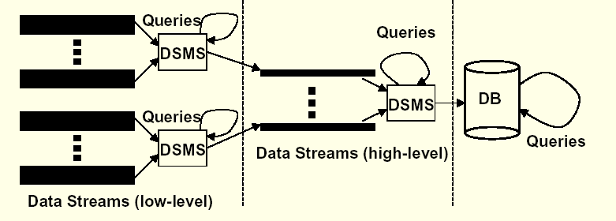
3-Level Architecture
Reduce tuples through several layered operations (several DSMSs)
Store results in static DB for later analysis
VLDB 2003 Tutorial [Koudas & Srivastava 2003]

Slide 18
Data models

Slide 19
Data Models
Real-time data stream: sequence of items that arrive in some order and may only be seen once.
Stream items: like relational tuples
  Relation-based: e.g., STREAM, TelegraphCQ and Borealis
  Object-based: e.g., COUGAR, Tribecca
Window models
  Direction of movements of the endpoints: fixed window, sliding window, landmark window
  Time-based vs. Tuple-based
  Update interval: eager (for each new arriving), lazy (batch processing), non-overlapping tumbling windows.
Notes:
In COUGAR, each sensor is defined as an abstract data type and sensors’ data is modeled as time series.

Slide 20
More on Windows
Mechanism for extracting a finite relation from an infinite stream
Desirable query semantic; data freshness; blocking operators..
Sliding:
window
Jumping:
window
window
window
window
window
Overlapping
window
window
window
window
window
window
window
(adapted from Jarle Søberg)

Slide 21
Timestamps
Used for tuple ordering and by the DSMS for defining window sizes (time-based)
Useful for the user to know when the the tuple originated
Explicit: set by the source of data
Implicit: set by DSMS, when it has arrived
Ordering is an issue
Distributed systems: no exact notion of time
Notes:
Distributed system: e.g., distributed join.

Slide 22
Stream Queries

Slide 23
Queries: DBMS vs DSMS
DBMS: one-time (transient) queries
DSMS: continuous (persistent) queries
DBMS: Arbitrary data access
DSMS: one-pass algorithms
DBMS: Unbounded memory requirements
DSMS: Limited memory/Cache; window techniques
DBMS: (mostly) exact query answer
DSMS: (mostly) approximate query answer
  We introduced approximate query processing
    sampling, synopses, sketches, wavelets, histograms, …
    apply over data streams?
DBMS: fixed query plans optimized at beginning
DSMS: adaptive query operators
Notes:
What types of query can be evaluated exactly using a given bounded amount of memory and queries must be approximated unless disk accesses are allowed.
Constrained ad-hoc queries to reference future data? Multi-query optimization?
Solution 2: construct summaries of past data – memory issues?

Slide 24
Query Optimization
DBMS: table based cardinalities used in query optimization
=> Problematic in a streaming environment
Cost metrics and statistics: accuracy and reporting delay vs. memory usage, output rate, power usage
Query optimization: query rewriting to minimize cost metric, adaptive query plans, due to changing processing time of operators, selectivity of predicates, and stream arrival rates
Query optimization techniques
  stream rate based, resource based, QoS based
Continuously adaptive optimization
Possibility that objectives cannot be met:
  resource constraints
  bursty arrivals under limited processing capability

Slide 25
Selections and Projections
Selections, (duplicate preserving) projections are straightforward
  Local, per-element operators
  Duplicate eliminating projection is like grouping
Projection needs to include ordering attribute
  No restriction for position ordered streams
SELECT sourceIP, time
FROM Traffic
WHERE length > 512

Slide 26
Joins
General case of join operators problematic on streams
  May need to join arbitrarily far apart stream tuples
  Equijoin on stream ordering attributes is tractable
Majority of work focuses on joins between streams with windows specified on each stream
SELECT A.sourceIP, B.sourceIP
FROM Traffic1 A [window T1], Traffic2 B [window T2]
WHERE A.destIP = B.destIP

Slide 27
Aggregations
General form:
  select G, F1 from S where P group by G having F2 op ϑ
  G: grouping attributes, F1,F2: aggregate expressions
  Window techniques are needed
Aggregate expressions:
  distributive: sum, count, min, max
  algebraic: avg
  holistic: count-distinct, median

Slide 28
Data Reduction Techniques
Aggregation: approximations e.g., mean or median
Load Shedding: drop random tuples
Sampling: only consider samples from the stream (e.g., random selection). Used in sensor networks.
Sketches: summaries of stream that occupy small amount of memory, e.g., randomized sketching
Wavelets: hierarchical decomposition
Histograms: approximate frequency of element values in stream

Slide 29
Holistic Aggregates: a case study

Slide 30
Holistic Aggregates
Holistic aggregates need the whole input to compute (no summary suffices)
  E.g., count distinct, need to remember all distinct items to tell if new item is distinct or not
So focus on approximating aggregates
  Adopt ideas from sampling, data reduction, streams etc.
Aggregate approximation:
  Sketch summaries
  Other mergable summaries
  Building uniform samples, etc…

Slide 31
Sketch Summaries
Sketch summaries are typically pseudo-random linear projections of data. Fits generate/fuse/evaluate model:
  Suppose input is vectors x_{i} and aggregate is F(∑_{i} x_{i})
  Sketch of x_{i}, g(x_{i}), is a matrix product Mx_{i}
  Combination of two sketches is their summation:
  f(g(x_{i}),g(x_{j})) = M(x_{i} + x_{j}) = Mx_{i} + Mx_{j} = g(x_{i}) + g(x_{j})
  Extraction function e() depends on sketch, different sketches allow approximation of different aggregates.

Slide 32
CM Sketch
Count-Min Sketch: can be used for point queries, range queries, quantiles, join size estimation.
Model input as a vector x_{i} of dimension U (U is large)
Creates a small summary as an array of w ╳ d in size
Use d hash function to map vector entries to [1..w]
W
d

Slide 33
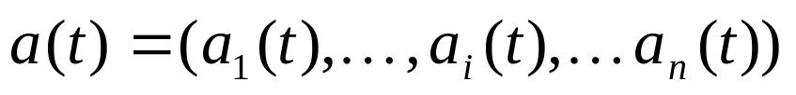
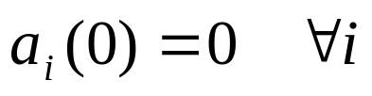


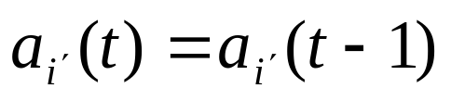
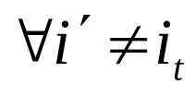
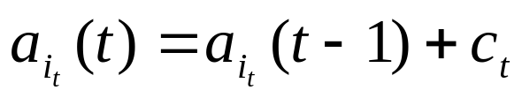
Data stream model
Consider the vector
initially
The
th
update

Slide 34



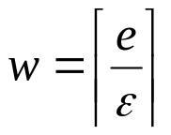
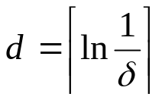


Count-Min Sketch
A Count-Min (CM) Sketch with parameters is represented by
a two-dimensional array counts with width and depth .
Given parameters , set and .
Each entry of the array is initially zero.
hash functions are chosen uniformly at random from a pairwise
independent family

Slide 35



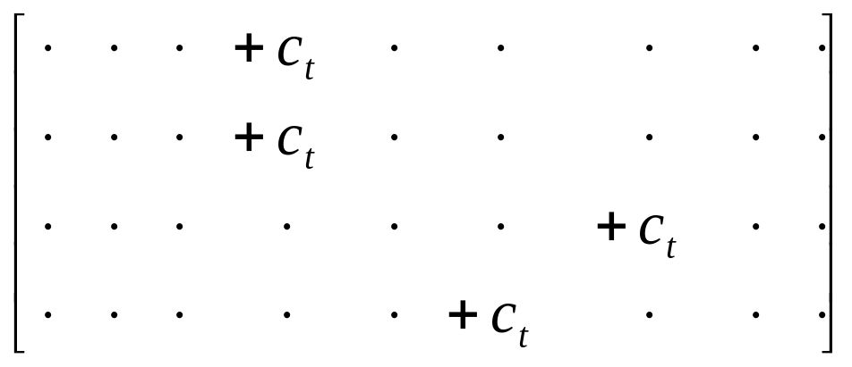



Update procedure
When arrives, set

Slide 36


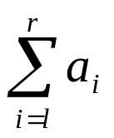

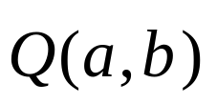
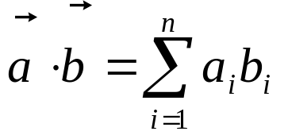
Approximate Query Answering Using CM Sketches
approx.
• point query
approx.
• range queries
• inner product queries
approx.

Slide 37
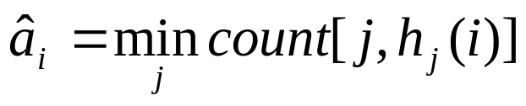
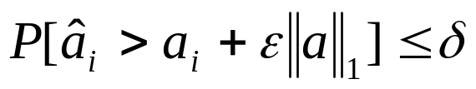


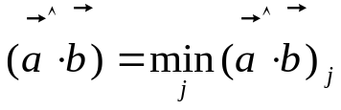
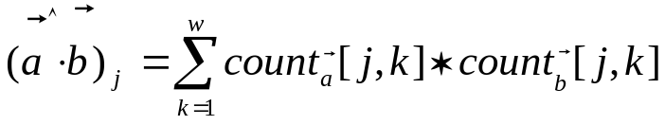
Approximate Query Answering Using CM Sketches
approx.
• point query
and
approx.
• range queries
from
point queries
• inner product queries
approx.
where

Slide 38
CM Sketch Structure
h₁(j)
+x_{i}[j]
j,x_{i}[j]
+x_{i}[j]
d
+x_{i}[j]
h_{d}(j)
+x_{i}[j]
w
Each entry in vector x is mapped to one bucket per row.
Merge two sketches by entry-wise summation
Estimate x_{i}[j] by taking min_{k} sketch[k,h_{k}(j)]
[Cormode, Muthukrishnan ’04]

Slide 39
Sketch Summary
Sketches | Space | Update Time | Query Time
Count-Min | 1/ε ; O(K) | 1 | 1
Bloom Filter | m ; Constant | k | k
Count Bloom Filter | mC; O(m) | k | k
Multi Counting Bloom filter | mC; O(m) | k | k
FM | ML O(M) | M | M
C = Number of Bits in the Counter in Bloom Filter
M = Number of Bit Maps used in FM Sketch
L = Number of Bits in FM Sketch
All Notations Described Earlier

Slide 40
Incremental query processing

Slide 41

Incremental query answering
5%/week in Web graphs
Real-life data is dynamic – constantly changes, ∆G
Re-compute Q(D⊕∆D) starting from scratch?
Changes ∆D are typically small
Compute Q(D) once, and then incrementally maintain it
Changes to the input
Old output
Incremental query processing:
  Input: Q, D, Q(D), ∆D
  Output: ∆M such that Q(D⊕∆D) = Q(D) ⊕ ∆M
New output
Changes to the output
When changes ∆D to the data D are small, typically so are the changes ∆M to the output Q(D⊕∆D)
Minimizing unnecessary recomputation
Notes:
Computing graph matches in batch style is expensive.
We find new matches by making maximal use of previous computation, without paying the price of the high complexity of graph pattern matching.

Slide 42
Why study incremental query answering?
Incremental query answering
Input: Q, D, Q(D), ∆D
Output: ∆M such that Q(D⊕∆D) = Q(D) ⊕ ∆M
E-commerce systems: a fixed set of (parameterized) queries
  Repeatedly invoked and evaluated
View maintenance: in response to changes to the underlying graph
Data synopsis: maintenance in the presence of changes
Indexing structure: 2-hop covers; landmarks…
An important issue for querying big data

Slide 43
Complexity of incremental problems
G. Ramalingam, Thomas W. Reps: On the Computational Complexity of Dynamic Graph Problems. TCS 158(1&2), 1996
Incremental query answering
Input: Q, D, Q(D), ∆D
Output: ∆M such that Q(D⊕∆D) = Q(D) ⊕ ∆M
The cost of query processing: a function of |D| and |Q|
incremental algorithms: |CHANGED|, the size of changes in
  the input: ∆G, and
  the output: ∆M
The updating cost that is inherent to the incremental problem itself
Bounded: the cost is expressible as f(|CHANGED|, |Q|)?
Optimal: in O(|CHANGED| + |Q|)?
The amount of work absolutely necessary to perform
Complexity analysis in terms of the size of changes

Slide 44
Incremental algorithms for pattern matching?
Graph pattern matching is expensive!
  NP-complete for subgraph isomorphism
  cubic-time for bounded simulation
  quadratic-time for simulation
Incremental graph pattern matching
How to measure complexity?
P
G
M(Gp,G)
typically small (5 %/week in Web graphs
∆G
∆M
P
G⊕∆G
M(Gp,G)⊕∆M
Computes new matches from old matches!
<#>

Slide 45
Incremental graph pattern matching

Slide 46
















Complexity of incremental algorithms
Result graphs
  Union of isomorphic subgraphs for subgraph isomorphism
  A graph Gr = (Vr, Er) for (bounded) simulation
    Vr : the nodes in G matching pattern nodes in Gp
    Er: the paths in G matching edges in Gp
Affected Area (AFF)
  the difference between Gr and Gr’, the result graph of Gp in G and G⊕∆G, respectively.
  |CHANGED| = |∆G| + |AFF|
Optimal, bounded and unbounded problem
  expressible by f(|CHANGED|)?
*
Ann, CTO
1
(bounded) simulation
edge-path relation
Ann, CTO
Dan, DB
subgraph isomorphism
2
1
Bill, Bio
P
P
Pat, DB
Pat, DB
Bill, Bio
Mat, Bio
Measure the complexity with the size of changes

Slide 47
Incremental simulation matching
Input: Q, G, Q(G), ∆G
Output: ∆M such that Q(G ⊕ ∆G) = Q(G) ⊕ ∆M
Incremental simulation is in
Batch updates
O(|∆G|(|Q||AFF| + |AFF|²)) time
in O(|AFF|) time
unbounded
Optimal for
  single-edge deletions and general patterns
  single-edge insertions and DAG patterns
General patterns and graphs; batch updates
2 times faster than its batch counterpart for changes up to 10%
Notes:
10:00

Slide 48
Semi-boundedness
Semi-bounded: the cost is a PTME function f(|CHANGED|, |Q|)
Incremental simulation is in
| Q | is small
O(|∆G|(|Q||AFF| + |AFF|²)) time
Independent of | G |
  for batch updates and general patterns
Independent of | G |
Semi-boundedness is good enough!
Notes:
15:00,16:00

Slide 49
Complexity of incremental algorithms (cont)
Insert e2
Insert e1
Ann, CTO
Dan, DB
Mat, Bio
e5
Insert e3
e3
Bill, Bio
Tom, Bio
e4
Insert e4
e2
Insert e5
Pat, DB
Don, CTO
Ross, Med
e1
∆G
G
P
Gr
Ann, CTO
Don, CTO
affected area
*
CTO
2
Pat, DB
Dan, DB
1
DB
1
Bio
Bill, Bio
Tom, Bio
Mat, Bio
<#>

Slide 50
Incremental Simulation matching
Problem statement
  Input: Gp, G, Gr, ∆G
  Output: ∆Gr, the updates to Gr s.t. Msim(G⊕∆G) = M(Gp,G)⊕∆M
Complexity
  unbounded even for unit updates and general patterns
  bounded for single-edge deletions and general patterns
  bounded for single-edge insertions and DAG patterns, within optimal time O(|AFF|)
  In O(|∆G|(|Gp||AFF| + |AFF|²)) for batch updates and general patterns
Measure the complexity with the size of changes
<#>

Slide 51
Incremental Simulation: optimal results
unit deletions and general patterns
e = (v, v’), if v and v’ are matches
delete e6
Ann, CTO
Dan, DB
1. identify match-match edges
Use a stack, upward propagation
Mat, Bio
2. find invalid match
Bill, Bio
e6
3. propagate affected
Area and refine matches
Pat, DB
Don, CTO
G
Q
Gr
Ann, CTO
affected area / ∆Gr
CTO
Pat, DB
Dan, DB
DB
e6
optimal with the size of changes
Bio
Bill, Bio
Mat, Bio
Linear time wrt. the size of changes
<#>

Slide 52
Incremental Simulation: optimal results
unit insertion and DAG patterns:
e = (v, v’), if v’ is a match and v a candidate
insert e7
Ann, CTO
Dan, DB
identify candidate-match
and candidate-candidate
edges
e = (v, v’), if v’ and v are candidate
Mat, Bio
Bill, Bio
2. find new valid matches
e7
3. propagate affected
Area and refine matches
Pat, DB
Don, CTO
G
Q
Gr
Ann, CTO
candidate
CTO
Dan, DB
Pat, DB
DB
e7
e7
optimal with the size of changes
Bio
Bill, Bio
Mat, Bio
Linear time wrt. the size of changes

Slide 53
Incremental subgraph isomorphism
Incremental subgraph isomorphism matching:
  Input: Gp, G, Gr, ∆G
  Output: ∆Gr, the updates to Gr s.t.
  Miso(G⊕∆G) = M_{iso}(Gp,G)⊕∆M
Incremental subgraph isomorphism:
  Input: Gp, G, Gr, ∆G
  Output: true if there is a subgraph in G⊕∆G that is isomorphi
  = M_{iso}(Gp,G)⊕∆M
Complexity
  IncIsoMatch is unbounded even for unit updates over DAG graphs for path patterns
  IncIso is NP-complete even for path pattern and unit update
<#>

Slide 54
Incremental subgraph isomorphism
Input: Q, G, M_{iso}(Q, G), ∆G
Output: ∆M such that M_{iso} (Q, G⊕∆G) = M_{iso}(Q, G) ⊕ ∆M
Boundedness and complexity
  Incremental matching via subgraph isomorphism is unbounded even for unit updates over DAG graphs for path patterns
  Incremental subgraph isomorphism is NP-complete even when G is fixed
not semi-bounded unless P = NP
  Input: Q, G, M(Q, G), ∆G
  Question: whether there exists a subgraph in G⊕∆G that is isomorphic to Q
What should we do?
Neither bounded nor semi-bounded
Notes:
18
We have proposed an algorithm to demonstrate the benefits of incremental matching, based on locality property. Upon updates to the data graphs, we only need to consider the subgraphs induced by the nodes and edges that are within k hops of the updated edges, where k is the diameter of the pattern graph Gp.

Slide 55
Summary
Data stream processing: Overview
Incremental query processing
Data synopsis in data stream processing

Slide 56
How to make big data small
Input: A class Q of queries
Question: Can we effectively find, given queries Q ∈ Q and any (possibly big) data D, a small D_{Q} such that
  Q(D) = Q(D_{Q})?
D
Q( )
Q( )
D_{Q}
Much smaller than D
  Data synopsis
  Boundedly evaluable queries
  Query answering using views
  Incremental evaluation
  Distributed query processing
Effective methods for making big data small

